Slide 1
Contacts and Networking Application

Slide 2

Team Name : App Monsters
Team Members :
Anshika Garg
Asma Shehzad
Bhavya Mishra : Team Lead
Divyani Chauhan
Pranav Hemant Kulkarni
Pravin Balasaheb Salunkhe
Kumari Priyanka
Raghav Sanjay Tripurwar
Simran Khetrapal
Supriya Kumari

Slide 3
Application Features
Users can register to the app.
Registered users can add and maintain their contacts in the system.
This information is private to that user,no other user or administrator can view the contact list information.
Registered users can search the system for other registered users based on city,state,company.
The system will show the names of all users in the search results.
A friend request can be sent to anyone in the system unless they have blocked the user.
If the request is accepted,then the user can view the full information of the newly added friend.
System administrator cannot view or modify the user’s databases,however they can view statistical data like number of users,most active users.They can disable users.

Slide 4
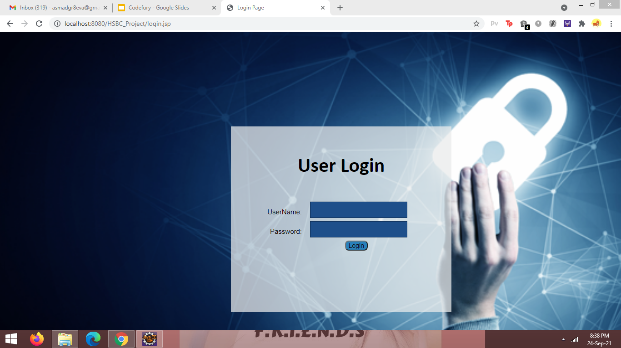
UI Snapshots

Slide 5
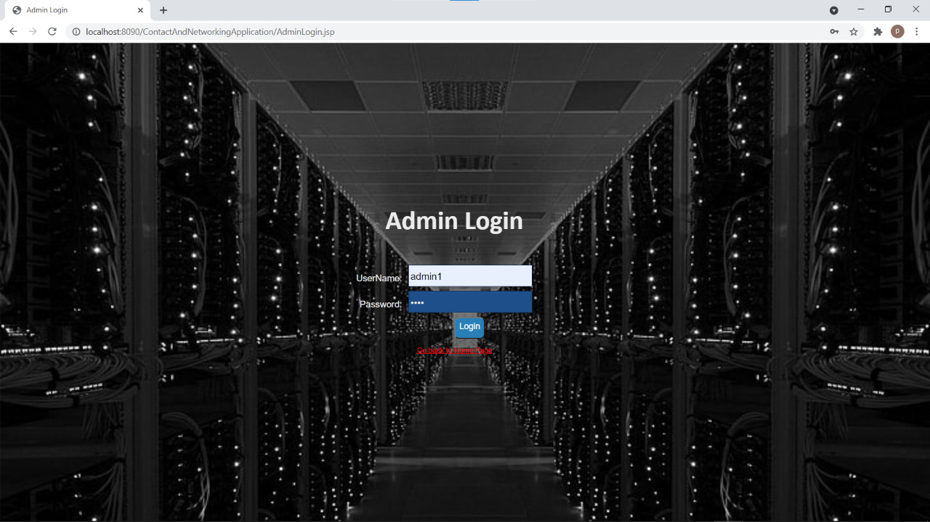

Slide 6
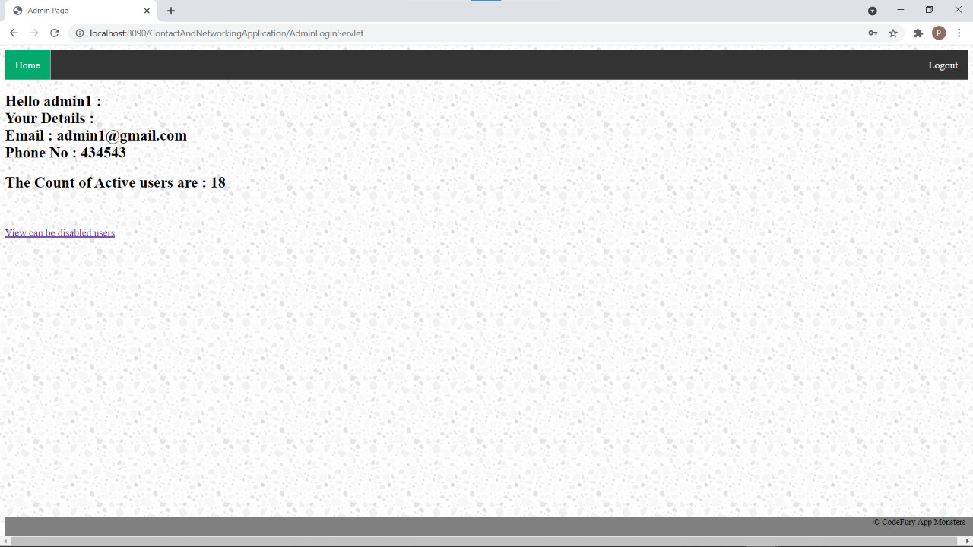

Slide 7
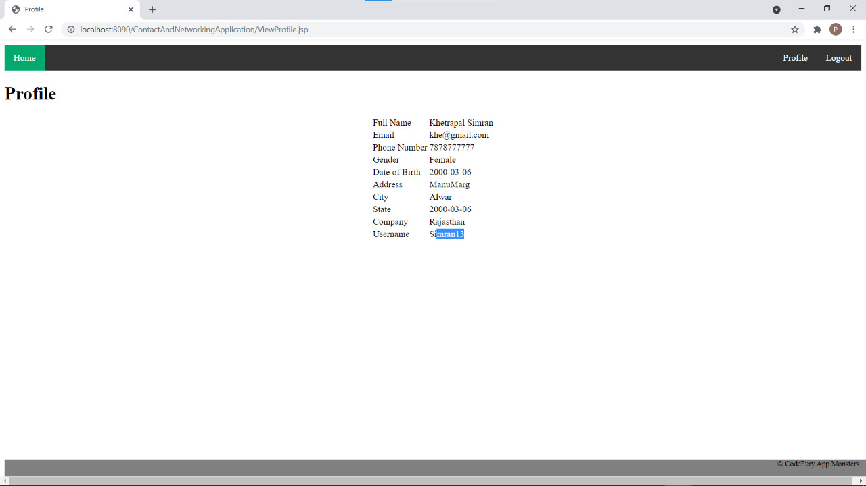

Slide 8
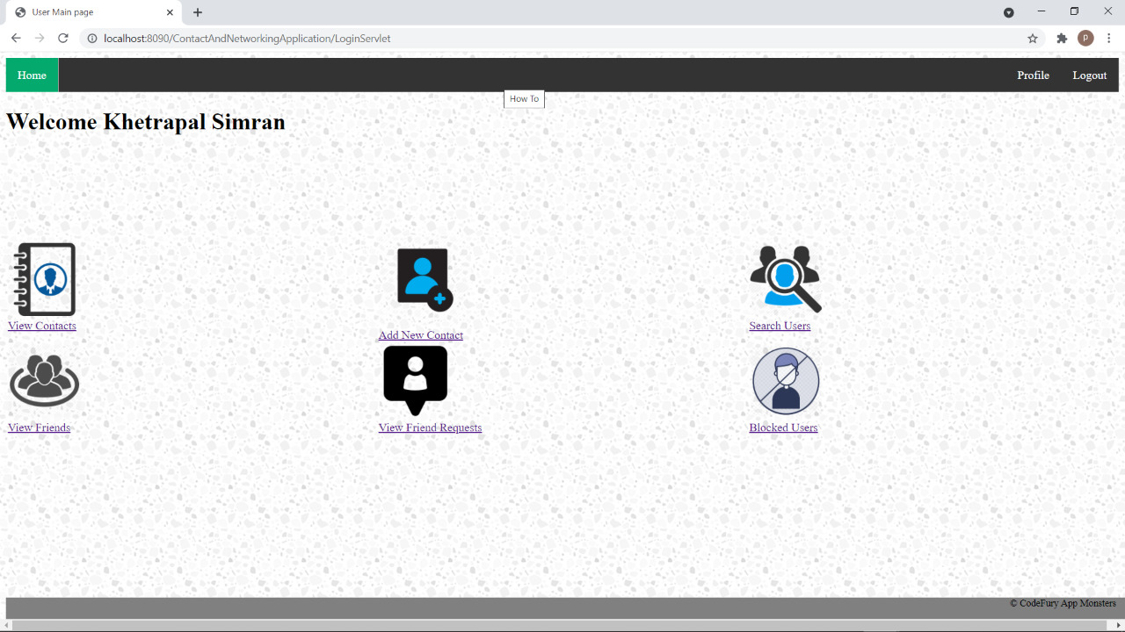

Slide 9
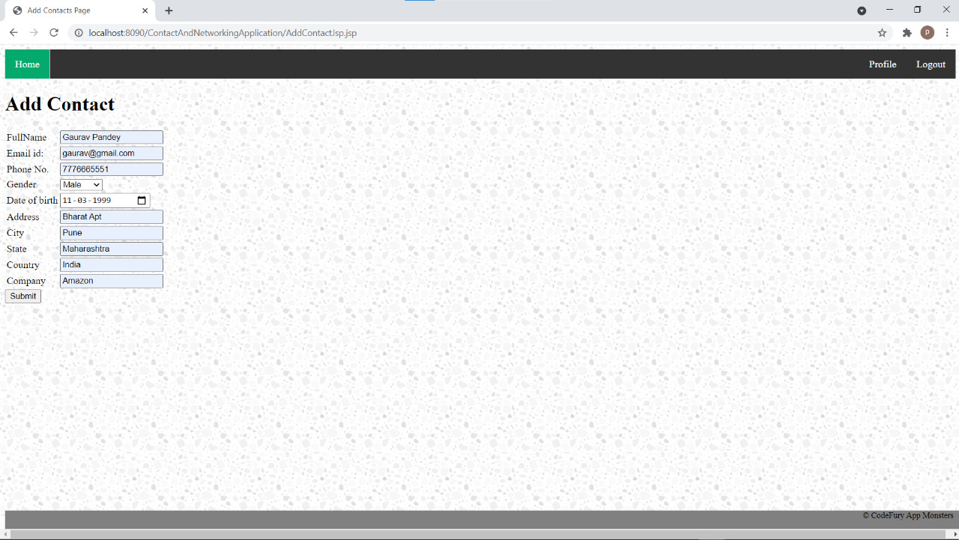

Slide 10
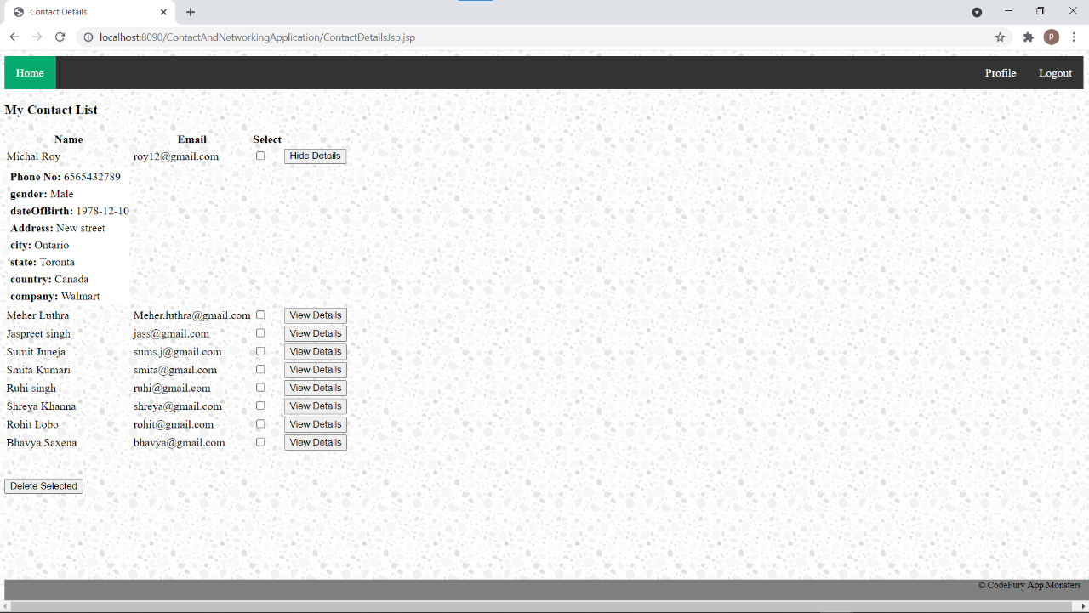

Slide 11
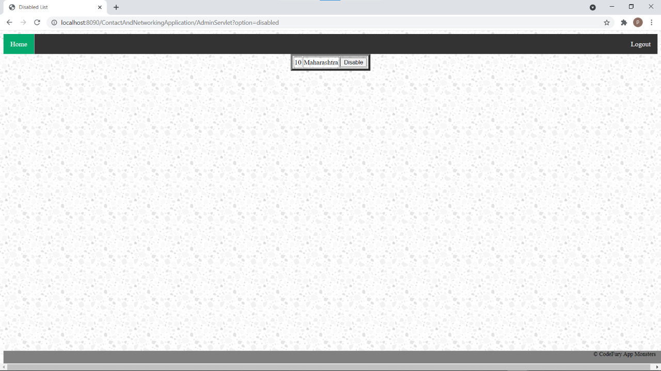

Slide 12
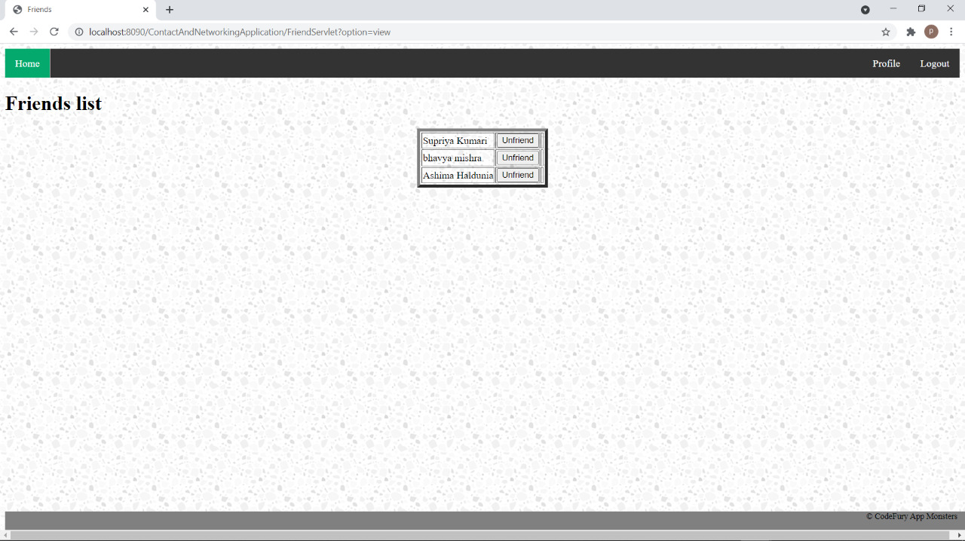

Slide 13
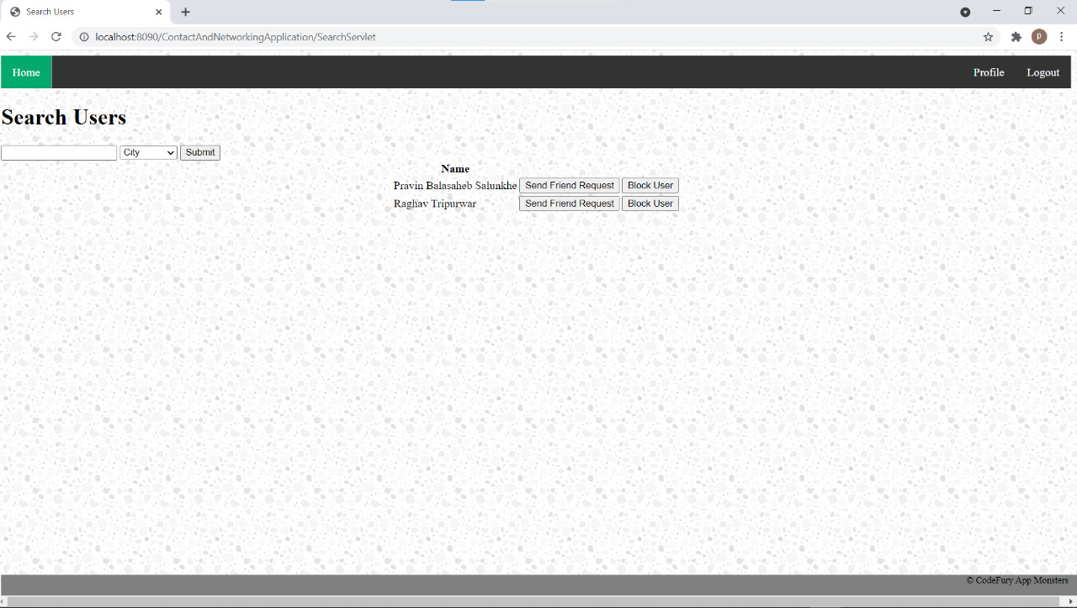

Slide 14
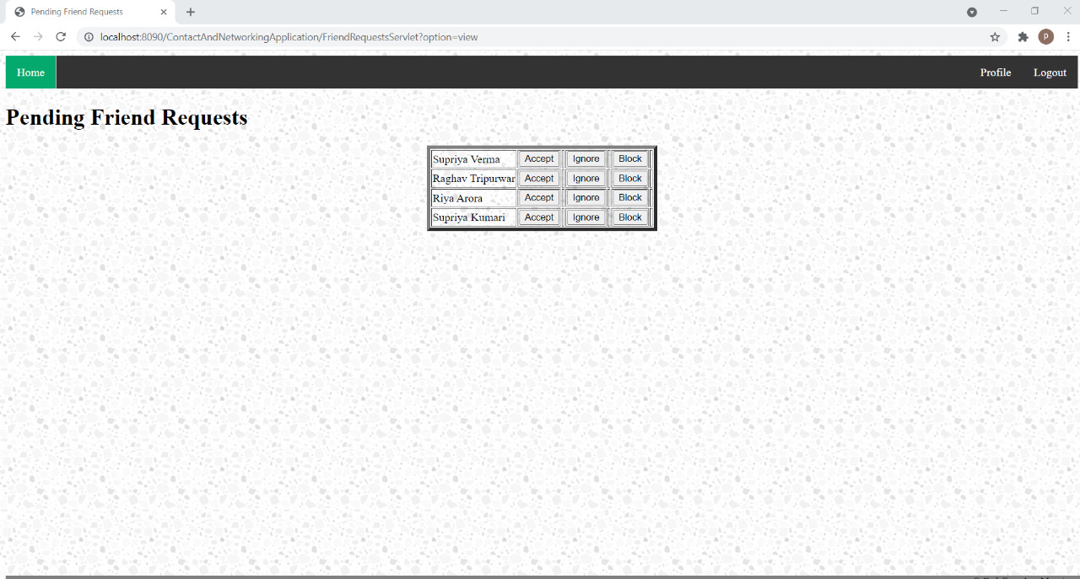

Slide 15
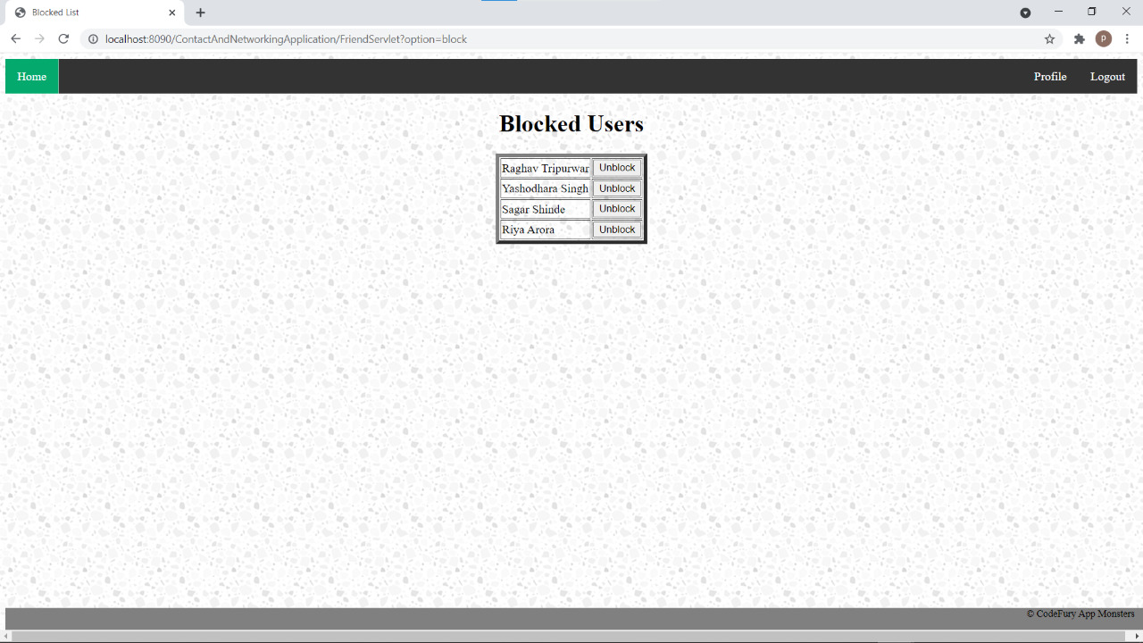

Slide 16





Tools used
Spring Tool Suite
MySQL Command Line Client
Dbeaver
GitHub
Git

Slide 17

Technologies
HTML
CSS
JAVA
JSON
MySQL
JAVASCRIPT
JQUERY
BOOTSTRAP

Slide 18
Collaboration
Collaboration or Teamwork help teammates open up and encourage each other.
Open communication is the key when working on a team and produces effective solutions in difficult group projects.
We learnt that wins and losses affect everyone on the team and it necessitates confidence in other’s distinct abilities.
We got great ideas as individuals in our team consists of different skills, knowledge, ideas and experience. When all these qualities were brought under one roof, a different and a unique thing came out of the box.
We made sure all of us were on the same page in our respective assigned jobs and no team member was lagging behind.
When anyone of us were in doubt or stuck somewhere, we were not blank or clueless for a long time.
We could immediately approach any other teammate and get our issue resolved and thus it saved us a lot of time.
Participating in team building exercises in a comfortable non-threatening situation helped us to develop confidence in ourselves.
We were able to take initiative, voice our opinions and discuss conflicts without feeling anxious.
Through the task and exercises in our project, we learnt more about the strengths, weaknesses, capabilities and fears of each other contributing to a deeper relationship and trust amongst ourselves.
We enjoyed and learnt a lot of things by working in a team. Having the same goal to achieve, and working together on it by filtering all our efforts, we instilled great team qualities in ourselves.

Slide 19
Thank You!

